Slide 1
Lecture 6. Modern Hash Functions
CSE 1204 Applied Cryptography
Lectures by Zhaxalykov T.M.

Slide 2
Agenda
The SHA-2 Family
Merkle-Damgård Construction
Length Extension Attacks
SHA-3 and the Sponge Construction
BLAKE2 and BLAKE3
Comparison and Selection Guide

Slide 3
1. The SHA-2 Family
1.1 SHA-2 Variants
1.2 SHA-256 Algorithm
1.3 Security Properties

Slide 4
The SHA-2 Family
The SHA-2 family, published by NIST in 2001, consists of SHA-224, SHA-256, SHA-384, SHA-512, SHA-512/224, and SHA-512/256. These functions remain the most widely deployed hash functions today.

Slide 5
1.1 SHA-2 Variants
SHA-256: Processes 512-bit blocks, produces 256-bit output. Uses 32-bit words and 64 rounds. Primary choice for most applications providing 128-bit collision resistance.
SHA-512: Processes 1024-bit blocks, produces 512-bit output. Uses 64-bit words and 80 rounds. Provides 256-bit collision resistance. Faster than SHA-256 on 64-bit architectures.
SHA-224 and SHA-384: Truncated versions of SHA-256 and SHA-512 respectively, using different initial values and truncating the final output.
SHA-512/256 and SHA-512/224: Use SHA-512 internal structure but produce 256-bit or 224-bit output. Faster on 64-bit systems than SHA-256.

Slide 6
1.2 SHA-256 Algorithm
We examine SHA-256 in detail as the representative SHA-2 function.
Step 1: Preprocessing
Append bit '1' to message
Append k zero bits where k is smallest non-negative solution to length + 1 + k ≡ 448 mod 512
Append 64-bit big-endian representation of original message length

Slide 7
1.2 SHA-256 Algorithm
Step 2: Initialize Hash Values
Eight 32-bit words (H₀ through H₇) initialized with first 32 bits of fractional parts of square roots of first 8 primes:
H₀ = 0x6a09e667, H₁ = 0xbb67ae85, H₂ = 0x3c6ef372, H₃ = 0xa54ff53a
H₄ = 0x510e527f, H₅ = 0x9b05688c, H₆ = 0x1f83d9ab, H₇ = 0x5be0cd19

Slide 8
1.2 SHA-256 Algorithm
Step 3: Process Blocks
For each 512-bit block:
Message Schedule: Expand 16 32-bit words into 64 words W₀...W₆₃:
For t = 0 to 15: W_t = M_t (first 16 words from message block)
For t = 16 to 63:
σ₀ = (W_{t-15} >>> 7) ⊕ (W_{t-15} >>> 18) ⊕ (W_{t-15} >> 3)
σ₁ = (W_{t-2} >>> 17) ⊕ (W_{t-2} >>> 19) ⊕ (W_{t-2} >> 10)
W_t = W_{t-16} + σ₀ + W_{t-7} + σ₁
Where >>> is right rotation, >> is right shift (all operations mod 2³²)

Slide 9
1.2 SHA-256 Algorithm
Compression Function: Initialize working variables a, b, c, d, e, f, g, h with current hash values H₀...H₇. For each of 64 rounds:
Σ₀ = (a >>> 2) ⊕ (a >>> 13) ⊕ (a >>> 22)
Σ₁ = (e >>> 6) ⊕ (e >>> 11) ⊕ (e >>> 25)
Ch(e,f,g) = (e AND f) ⊕ ((NOT e) AND g)
Maj(a,b,c) = (a AND b) ⊕ (a AND c) ⊕ (b AND c)
T₁ = h + Σ₁ + Ch(e,f,g) + K_t + W_t
T₂ = Σ₀ + Maj(a,b,c)
h = g; g = f; f = e; e = d + T₁
d = c; c = b; b = a; a = T₁ + T₂
K_t are 64 round constants (fractional parts of cube roots of first 64 primes).
After 64 rounds, add working variables to current hash: H₀ += a, H₁ += b, ..., H₇ += h

Slide 10
1.2 SHA-256 Algorithm
Step 4: Output
Concatenate H₀ || H₁ || ... || H₇ to produce 256-bit hash.

Slide 11
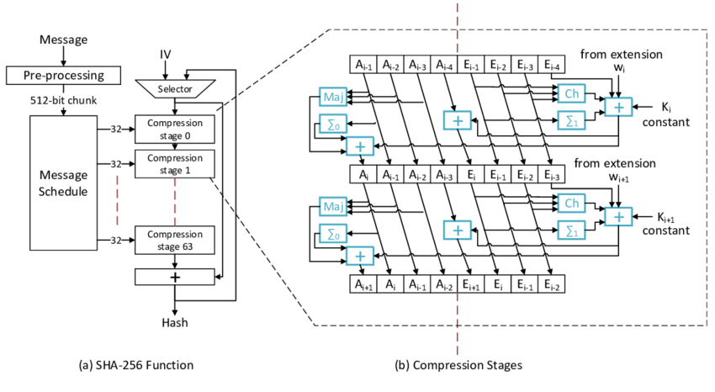

Slide 12
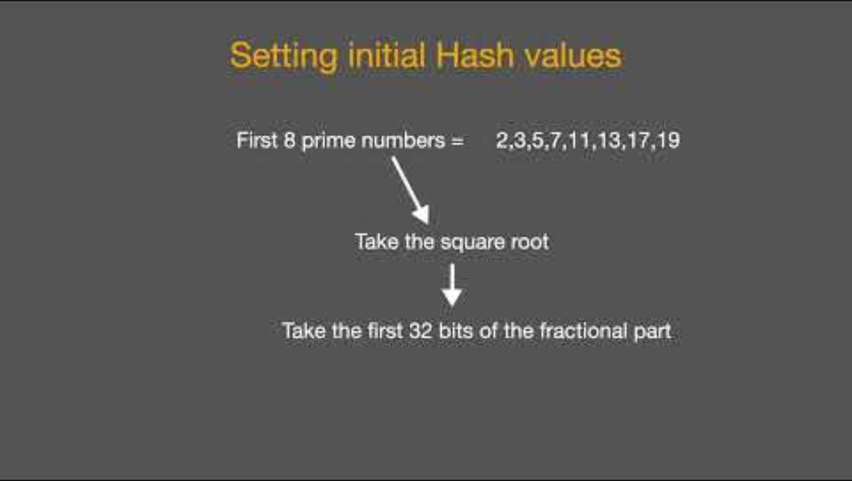

Slide 13
Example 1.1: SHA-256 Computation
Message: 'abc'
Binary: 01100001 01100010 01100011
After padding: message + 1 + 423 zeros + 64-bit length = 512 bits
Process through 64 rounds with message schedule and compression
SHA-256('abc') = ba7816bf8f01cfea414140de5dae2223b00361a396177a9cb410ff61f20015ad

Slide 14
1.3 Security Properties
Collision Resistance: SHA-256 provides 128-bit security (2¹²⁸ operations), SHA-512 provides 256-bit security (2²⁵⁶ operations).
Preimage Resistance: SHA-256 requires 2²⁵⁶ operations, SHA-512 requires 2⁵¹² operations—both computationally infeasible.
Current Status: No practical attacks on full SHA-256 or SHA-512 after 20+ years of analysis. Best known collision attacks are still close to birthday bound. SHA-2 is considered secure for all applications.

Slide 15
2. Merkle-Damgård Construction
2.1 Construction Overview
2.2 Security Theorem
2.3 Padding Schemes

Slide 16
2. Merkle-Damgård Construction
The Merkle-Damgård (MD) construction is the foundation for MD5, SHA-1, and SHA-2 families. Understanding it explains both their strengths and vulnerabilities.

Slide 17
2.1 Construction Overview
Definition 2.1 (Merkle-Damgård Construction): To hash arbitrary-length message M: (1) Pad M to multiple of block size, (2) Split into blocks M₁, M₂, ..., Mₙ, (3) Initialize state H₀ with fixed IV, (4) Iteratively compute Hᵢ = f(Hᵢ₋₁, Mᵢ) using compression function f, (5) Output final state Hₙ as hash.

Slide 18
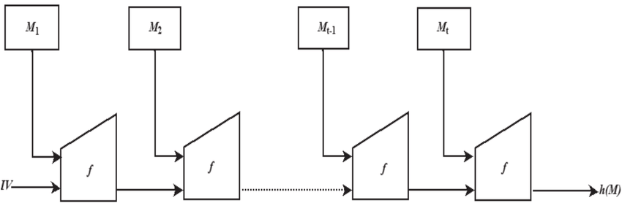

Slide 19
2.2 Security Theorem
Theorem 2.1 (Merkle-Damgård Security): If the compression function f is collision-resistant, then the hash function constructed via Merkle-Damgård is collision-resistant.

Slide 20
2.2 Security Theorem
Proof (by contradiction):
Suppose we find collision H(M) = H(M') for messages M ≠ M'. Let M = M₁||M₂||...||Mₙ and M' = M'₁||M'₂||...||M'ₘ after padding.
If n = m and all blocks match (Mᵢ = M'ᵢ for all i), then M = M', contradiction. So either n ≠ m or some block differs.
Working backwards from final hash: If Hₙ = H'ₘ and (Hₙ₋₁, Mₙ) ≠ (H'ₘ₋₁, M'ₘ), we have collision in f. Otherwise, continue backwards until finding first difference—this gives collision in f, contradicting assumption. ∎
This theorem is why Merkle-Damgård is widely used - it reduces hash function security to compression function security.

Slide 21
2.3 Padding Schemes
Proper padding is critical for security. MD padding (used in MD5, SHA-1, SHA-2):
Append bit '1'
Append k zero bits where length + 1 + k ≡ 448 mod 512 (for 512-bit blocks)
Append 64-bit representation of original message length
This ensures: (1) Every message has unique padding, (2) Length is encoded, preventing length manipulation, (3) No message is prefix of another after padding.

Slide 22
3. Length Extension Attacks
3.1 The Attack
3.2 Vulnerable Constructions
3.3 Mitigations

Slide 23
3. Length Extension Attacks
Length extension is a fundamental weakness of Merkle-Damgård construction that affects MD5, SHA-1, and SHA-2 (but not SHA-3).

Slide 24
3.1 The Attack
Given H(M) without knowing M, an adversary can compute H(M || padding || X) for any chosen X, where padding is the MD padding for M.
Why This Works:
The hash H(M) is the final internal state after processing M. To compute H(M || padding || X), the adversary: (1) Uses H(M) as the initial state, (2) Processes X as additional blocks, (3) Obtains H(M || padding || X) without knowing M.

Slide 25
Example 3.1: Length Extension Attack
Secret: K = 'secretkey'
Message: M = 'message'
MAC: H(K || M) = SHA-256('secretkeymessage')
= 3d7e6c10e8f2f7d6c0a8d5b3e9f1a2c4...
Adversary knows H(K || M) but not K. They can compute:
H(K || M || padding || 'malicious')
by using H(K || M) as starting state and processing 'malicious'
This creates valid MAC for extended message without knowing secret key K!

Slide 26
3.2 Vulnerable Constructions
Naive MAC: H(K || M) is vulnerable. Adversary extends M arbitrarily.
H(M || K): Also vulnerable—adversary knows intermediate state after M.

Slide 27
3.3 Mitigations
HMAC: HMAC = H((K ⊕ opad) || H((K ⊕ ipad) || M)) is immune. The outer hash prevents extension.
Truncation: Output only partial hash (SHA-512/256). Adversary cannot use truncated output as internal state.
SHA-3: Sponge construction (next section) is immune by design.
Critical Lesson: Never use H(K || M) or H(M || K) for MACs with Merkle-Damgård hashes. Always use HMAC or authenticated encryption.

Slide 28


Slide 29
4. SHA-3 and the Sponge Construction
4.1 The SHA-3 Competition
4.2 Sponge Construction
4.3 Keccak/SHA-3 Specification
4.4 Security Advantages
4.5 Performance Considerations

Slide 30
4. SHA-3 and the Sponge Construction
SHA-3, standardized by NIST in 2015, represents a fundamentally different design philosophy from SHA-2. It was selected through an open competition following concerns about SHA-2's Merkle-Damgård structure.

Slide 31
4.1 The SHA-3 Competition
After theoretical attacks on MD5 and SHA-1, NIST initiated a public competition (2007-2012) to develop SHA-3:
2007: Competition announced, 64 submissions
2008: 51 accepted candidates
2009: 14 advanced to round 2
2010: 5 finalists (BLAKE, Grøstl, JH, Keccak, Skein)
2012: Keccak selected as SHA-3
Selection criteria: Security, performance, algorithm clarity, and diversity from SHA-2.

Slide 32
4.2 Sponge Construction
Definition 4.1 (Sponge Construction): A sponge function operates on state of b bits, split into rate r bits and capacity c bits (where b = r + c). It has two phases: (1) Absorbing: XOR message blocks of r bits into state, apply permutation f. (2) Squeezing: Extract r bits at a time, applying f between extractions, until desired output length reached.

Slide 33
4.2 Sponge Construction
Visual representation:
State = [r bits rate | c bits capacity]
Absorbing: M₁ → XOR → [f] → M₂ → XOR → [f] → ...
Squeezing: [f] → output r bits → [f] → output r bits → ...
Key insight: Capacity c never affected by input or visible in output—it provides security margin.

Slide 34
4.3 Keccak/SHA-3 Specification
SHA-3 uses Keccak-f[1600] permutation on 1600-bit (200-byte) state. Common variants:
SHA3-256: r = 1088 bits, c = 512 bits, output = 256 bits
SHA3-512: r = 576 bits, c = 1024 bits, output = 512 bits
Security = min(output_length/2, capacity/2) bits
Keccak-f[1600] Permutation:
State viewed as 5×5 array of 64-bit lanes. Each round applies five operations (θ, ρ, π, χ, ι) mixing the state. 24 rounds total.
These operations provide strong diffusion: every bit affects every other bit within a few rounds.

Slide 35
Example 4.1: SHA3-256 Computation
Message: 'abc'
Absorb: Pad to 1088 bits, XOR into first r bits, apply f
Squeeze: Extract first 256 bits of state
SHA3-256('abc') = 3a985da74fe225b2045c172d6bd390bd855f086e3e9d525b46bfe24511431532

Slide 36
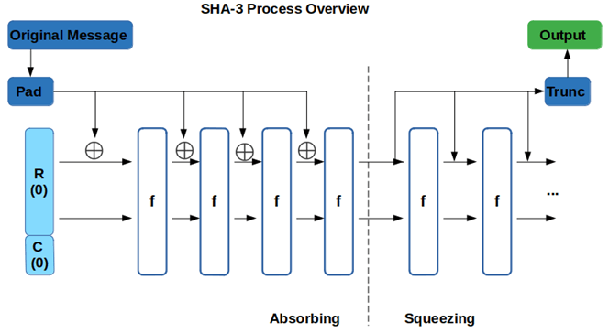

Slide 37


Slide 38
4.4 Security Advantages
No Length Extension: Capacity c is never revealed, making length extension impossible. Can use H(K || M) safely.
Flexibility: Can extract arbitrary output length (useful for key derivation, extendable output functions).
Security Proof: Sponge construction has formal security proofs relating security to permutation properties.
Diversification: Completely different design from SHA-2, reducing risk of similar vulnerabilities.

Slide 39
4.5 Performance Considerations
SHA-3 is generally slower than SHA-2 in software on current processors (lacks hardware acceleration), but competitive in hardware implementations. Future processors may include SHA-3 acceleration.
Typical speeds: SHA-256 with AES-NI: ~5 GB/s, SHA3-256 software: ~1.5 GB/s

Slide 40
5. BLAKE2 and BLAKE3
5.1 BLAKE2
5.2 BLAKE3
5.3 Use Cases

Slide 41
5. BLAKE2 and BLAKE3
BLAKE2 and BLAKE3 represent the performance-optimized branch of modern hash function design.

Slide 42
5.1 BLAKE2
BLAKE2, published in 2012, evolved from BLAKE (SHA-3 finalist). Optimized for speed on modern processors.
Variants:
BLAKE2b: Optimized for 64-bit platforms, output 1-512 bits
BLAKE2s: Optimized for 32-bit platforms, output 1-256 bits

Slide 43
5.1 BLAKE2
Design Features:
HAIFA construction (improved Merkle-Damgård)
ChaCha-inspired ARX operations (Add, Rotate, XOR)
Built-in support for keyed hashing (MAC mode)
Configurable: salt, personalization, tree hashing
Performance: BLAKE2b faster than MD5, SHA-1, SHA-256 on modern CPUs. Typical: ~1-3 GB/s without hardware acceleration.
Security: No known attacks. Conservative design with large security margin. Widely trusted.

Slide 44
5.2 BLAKE3
BLAKE3, released in 2020, is an extreme performance optimization of the BLAKE family.
Key Innovations:
Merkle tree structure: Parallel processing of message chunks
Single algorithm: No separate variants for different platforms
SIMD-friendly: Optimized for AVX-2, AVX-512, NEON
Extendable output: Can produce arbitrary-length output
Performance: Extremely fast: 3-10 GB/s on modern CPUs, 50+ GB/s with AVX-512. Outperforms all other cryptographic hashes.

Slide 45
Example 5.1: Performance Comparison
Hash Function | Software Speed (CPU) | Hardware Accel (Specialized) | Key Takeaway
SHA-256 | ~0.5 GB/s | ~5-10 GB/s (Intel SHA-NI) | Standard, but slow on older CPUs.
SHA-512 | ~0.8 GB/s | Limited | Faster than SHA-256 on 64-bit systems.
SHA3-256 | ~1.5 GB/s | Limited | Modern, secure, but hardware support is rare.
BLAKE2b | ~1.3 GB/s | None | Extremely fast in pure software/C.
BLAKE3 | ~3-10 GB/s | ~50 GB/s (AVX-512) | The current "speed king."

Slide 46
5.3 Use Cases
BLAKE2: General-purpose alternative to SHA-256. File checksums, password hashing (though Argon2 preferred), blockchain (some cryptocurrencies use BLAKE2).
BLAKE3: High-performance applications: data deduplication, file integrity at scale, cloud storage, large file processing.

Slide 47
6. Comparison and Selection Guide
6.1 Comprehensive Comparison
6.2 Selection Guidelines
6.3 Migration Recommendations

Slide 48
6.1 Comprehensive Comparison
Hash | Output | Construction | Speed | Status | Best For
MD5 | 128-bit | Merkle-Damgård | Fast | BROKEN | Nothing (Legacy only)
SHA-1 | 160-bit | Merkle-Damgård | Fast | ️ DEPRECATED | Nothing (Legacy only)
SHA-256 | 256-bit | Merkle-Damgård | Good | SECURE | General purpose (Bitcoin)
SHA-512 | 512-bit | Merkle-Damgård | Good | SECURE | High security (64-bit CPUs)
SHA3-256 | 256-bit | Sponge | Moderate | SECURE | Diversification / Hardware
BLAKE2 | 1–512 | HAIFA | Very Fast | SECURE | Software Performance
BLAKE3 | Variable | Merkle Tree | Extreme | SECURE | Maximum Performance

Slide 49
6.2 Selection Guidelines
Standards Compliance: SHA-256 or SHA-512. Required for FIPS, government, many compliance frameworks.
Maximum Security: SHA-512 or SHA3-512. 256-bit collision resistance.
Performance Critical: BLAKE3 (extreme), BLAKE2 (very fast), or SHA-256 with AES-NI.
Embedded Systems: BLAKE2s (32-bit optimized) or lightweight SHA-256 implementations.
Blockchain/Cryptocurrency: Bitcoin: SHA-256, Ethereum: Keccak-256 (pre-standard SHA-3), some altcoins: BLAKE2.
MACs without HMAC: SHA-3 or BLAKE2 (both support keyed mode safely).

Slide 50
6.3 Migration Recommendations
If using MD5/SHA-1: Migrate to SHA-256 immediately
SHA-256 deployments: No urgent need to migrate, but SHA-512 or SHA-3 offer future-proofing
New systems: SHA-256 default, BLAKE2/BLAKE3 for performance, SHA-3 for diversification
Support multiple algorithms for crypto-agility

Slide 51
7. Conclusion
This lecture covered modern hash function design and deployment. Key takeaways:
SHA-2 (SHA-256, SHA-512) remains secure and widely deployed after 20+ years
Merkle-Damgård construction is vulnerable to length extension—use HMAC for MACs
SHA-3 provides different design approach (sponge) with length extension immunity
BLAKE2/BLAKE3 offer superior performance while maintaining security
Choose hash function based on requirements: compliance, security, performance

Slide 52
7.1 Looking Forward
Next Lecture (Week 7): Hash Function Applications. We will study password hashing (bcrypt, Argon2, scrypt), Merkle trees for data structures, hash-based signatures, and commitment schemes.

Slide 53
7.2 Preparation
Read Aumasson, Chapter 7: Password Hashing
Review: Key derivation functions, memory-hard functions
Lab: Implement SHA-256 message schedule, experiment with BLAKE2

Slide 54
References
Aumasson, J.-P., et al. (2013). BLAKE2: simpler, smaller, fast as MD5. In ACNS 2013.
Bertoni, G., et al. (2011). Cryptographic sponge functions. STMicroelectronics.
Damgård, I. (1989). A design principle for hash functions. In Advances in Cryptology—CRYPTO '89.
National Institute of Standards and Technology. (2015). SHA-3 Standard: Permutation-Based Hash and Extendable-Output Functions (FIPS PUB 202).
O'Connor, J., Aumasson, J.-P., et al. (2020). BLAKE3: one function, fast everywhere.

